Slide 1
Software Defined Networking (SDN) training
Module 4: Datacenter Firewall

Slide 2
Copyright and terms of use
Copyright and trademarks
This training package is proprietary and confidential and is intended only for uses described in the training materials. Content and software is provided to you under a Non-Disclosure Agreement and cannot be distributed. Copying or disclosing all or any portion of the content and/or software included in such packages is strictly prohibited.
The contents of this package are for informational and training purposes only and are provided "as is" without warranty of any kind, whether express or implied, including but not limited to the implied warranties of merchantability, fitness for a particular purpose, and non-infringement.
Conditions and terms of use
Training package content, including URLs and other Internet Web site references, is subject to change without notice. Because Microsoft must respond to changing market conditions, the content should not be interpreted to be a commitment on the part of Microsoft, and Microsoft cannot guarantee the accuracy of any information presented after the date of publication. Unless otherwise noted, the companies, organizations, products, domain names, e-mail addresses, logos, people, places, and events depicted herein are fictitious, and no association with any real company, organization, product, domain name, e-mail address, logo, person, place, or event is intended or should be inferred.

Slide 3
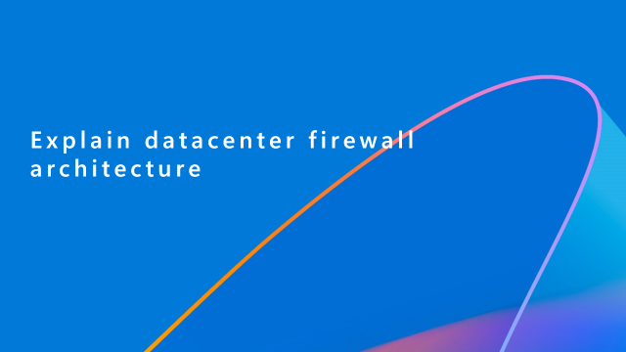
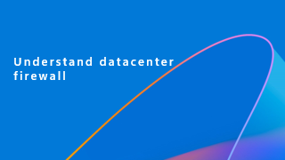
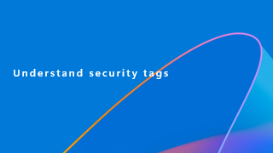
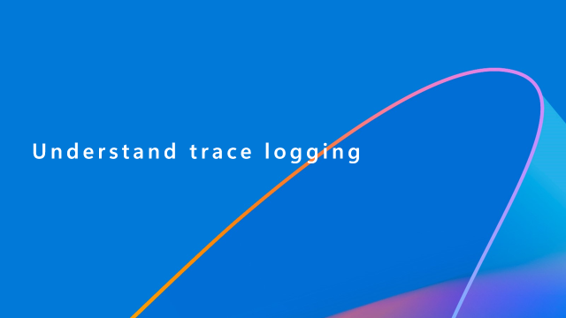
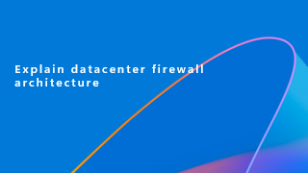
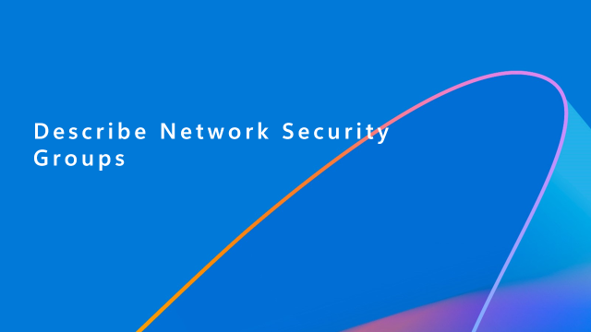

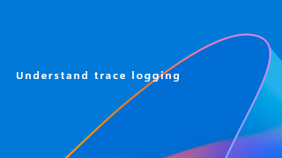
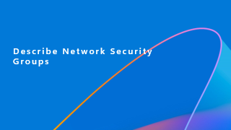
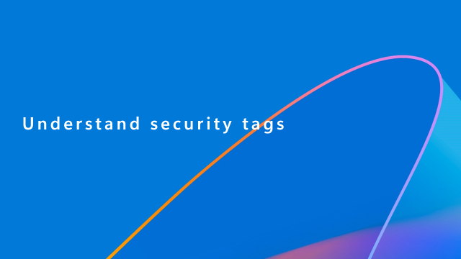
Learning objectives
By the end of this module, you will be able to:

Slide 4
Understand datacenter firewall

Slide 5
Important
In Windows Admin Center 2208+ builds, Access Control Lists (ACLs) have been renamed to Network Security Groups (NSGs) to align with Azure and Azure Stack.
ACLs and NSGs can be used interchangeably as of this content writing as NSGs will be the public facing resource. ACLs will still be used internally as part of a control / data plane configuration.

Slide 6
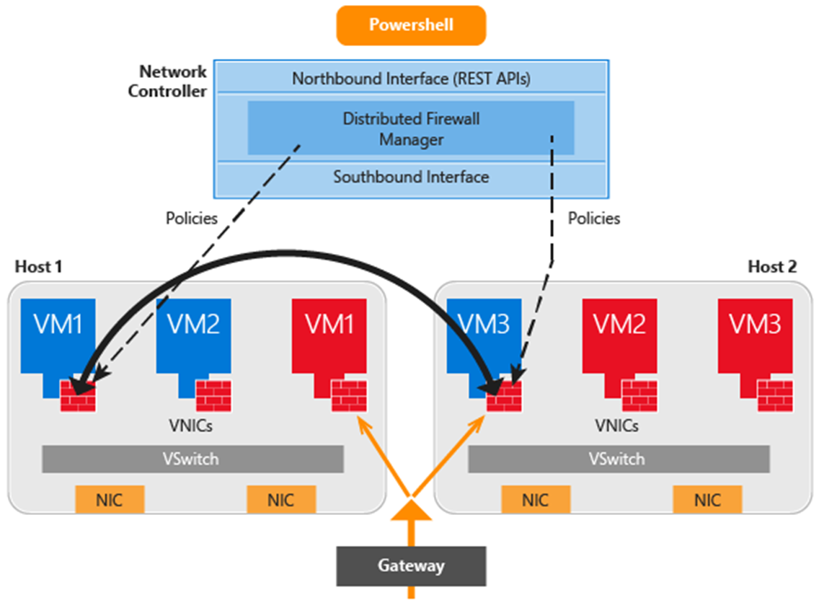
Datacenter firewall overview
5-tuple stateful, multi-tenant firewall.
Protocol
Source IP address
Source port number
Destination IP address
Destination port number
Protects east-west and north-south traffic flows.
Firewall policies are enforced at the virtual switch port of each tenant VM.

Slide 7
Features
Cloud Service Admins
Tenant Admins
A highly scalable, manageable, and diagnosable software-based firewall solution that can be offered to tenants.
Freedom to move tenant VMs to different compute hosts without breaking tenant firewall policies.
Deployed as a virtual switch port host agent firewall.
Tenant VMs get the policies assigned to their virtual switch host agent firewall.
Firewall rules are configured in each virtual switch port, independent of the actual host running the VM.
Offers protection to tenant VMs independent of the tenant guest operating system.
Ability to define firewall rules to help protect internet-facing workloads and internal workloads on networks.
Ability to define firewall rules to help protect traffic between VMs on the same Layer 2 (L2) subnet as well as between VMs on different L2 subnets.
Ability to define firewall rules to help protect and isolate network traffic between tenant on-premises networks and their virtual networks at the service provider.
Ability to apply firewall policies to traditional VLAN networks and overlay-based virtual networks.

Slide 8
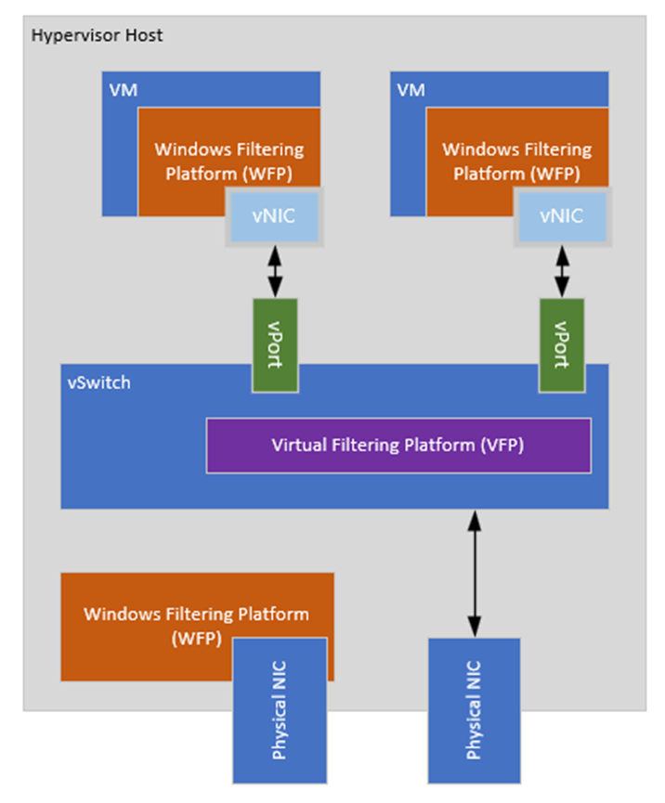
Why datacenter firewall?
Traffic routing through the virtual switch isn’t processed by Windows Filtering Platform (WFP) on the host.
Datacenter Firewall enables cloud operators to ensure tenants are adhering to certain security standards.
Notes:
Windows Firewall Policy (WFP), however traffic going through a virtual switch is not processed by WFP.
WFP within the Guest OS is processed as normal.
As an operator or administrator, ensure that guests are adhering to good policies as they may not know which Windows Firewall policies are configured within the Guest OS.

Slide 9
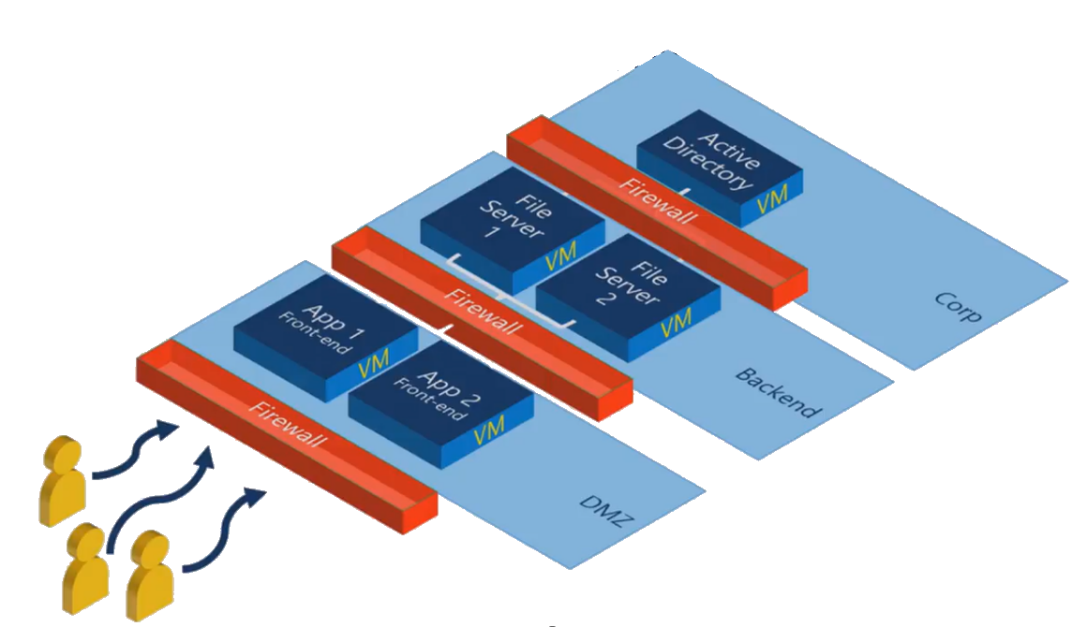
Traditional security boundaries
Firewall devices are implemented into network architecture to create zones or boundaries.
Requires overhead to maintain and modify policies that may require unique/independent configuration per device.
Notes:
Traditionally, security boundaries look like the diagram above where “zones” or “boundaries” are created, and firewall appliance is put between each boundary to provide security. This security boundary model doesn’t offer the best protection and can require a lot of administration.

Slide 10
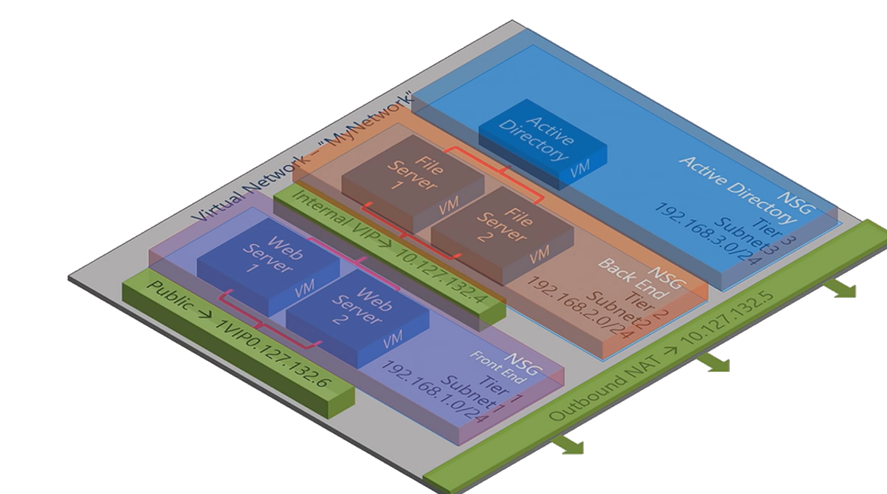
SDN security boundaries
NSGs can apply security policy across all VMs within a subnet.
Each subnet can have its own ACL and is inherited automatically for new deployments.
Traffic between subnets can be allowed or blocked based on 5-tuple rules.
VMs and virtual networks can have a public virtual IP attached to allow outbound/inbound communications.
Notes:
By utilising Access Control Lists (ACLs) we can apply security policy across the subnet which will automatically apply to all new virtual machines added into the Tier
In this diagram, a single Virtual Network has been deployed, with multiple subnets where virtual machines are deployed to. Each of the subnets have their own Network Security Group (NSG) which the network interfaces for the associated VMs will automatically inherit upon provisioning. Traffic between the subnets by default are allowed, however further restrictions can be made to only expose certain endpoints within the subnet.
Network Interfaces within the Virtual Network, will have an outbound NAT to enable outbound external connectivity. No traffic is allowed from external from the Virtual Network to the File Server and AD subnets. Web Server 1 and 2, have their own outbound NAT (Public VIP) attached to enable incoming/outgoing.

Slide 11

Lab
There’s no lab for the Datacenter firewall overview topic.

Slide 12
Knowledge check
How are firewall policies enforced?
Notes:
See answers at end of the deck.

Slide 13
Explain datacenter firewall architecture

Slide 14
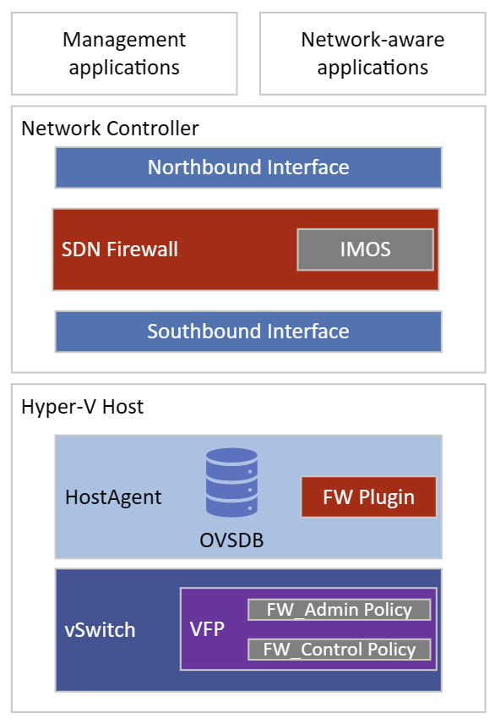
Architecture overview
Like other NC services, SDN Firewall (SDNFW) will receive REST operations via northbound API.
SDNFW stores its configuration within the Service Fabric Partition Database.
SDNFW communicates via southbound interface using OVSDB protocol on each individual server.
The FW plugin within NCHostAgent will detect new goal state within the database and will push the policies via the Virtual Filtering Platform (VFP) API.

Slide 15
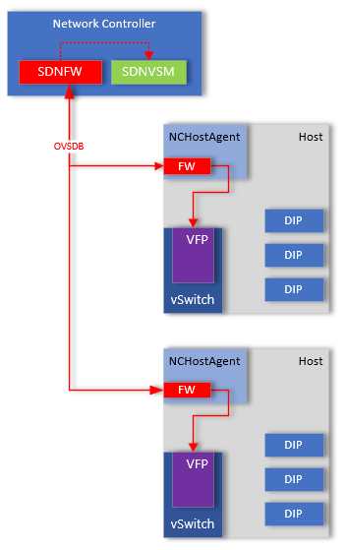
Policy configuration
SDN firewall service configures the ACLs.
Policies are pushed via NC southbound API over OVSDB.
FW Plugin will monitor the ms_firewall database.
FW Plugin will calculate policy and push policy to VFP.

Slide 16
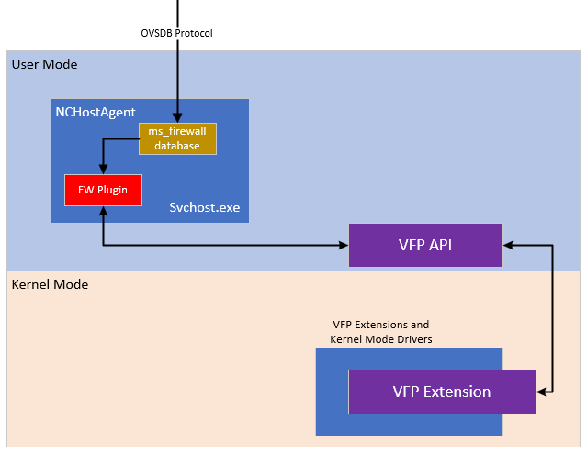
NCHostAgent
FWM service pushes policies into the ms_firewall database using OVSDB protocol.
FW Plugin within NCHostAgent detects the changes and calculates policies.
FW Plugins programs the policies via the VFP API.
Rules are then applied on the port for the NIC.
Notes:
Now that we have a resource assigned to NSG, the Network Controller (OVSDB Client) sends the policy in OVSDB format to the OVSDB server (running within NCHostAgent) and programs the ms_firewall database.
The NC Host Agent FW plug-in detects the changes, performs the policy calculation and sends the information to the VFP API which programs the flow rules into the virtual switching using VFP extensions. We can examine the OVSDB tables and VFP switch to see the policies configured.

Slide 17
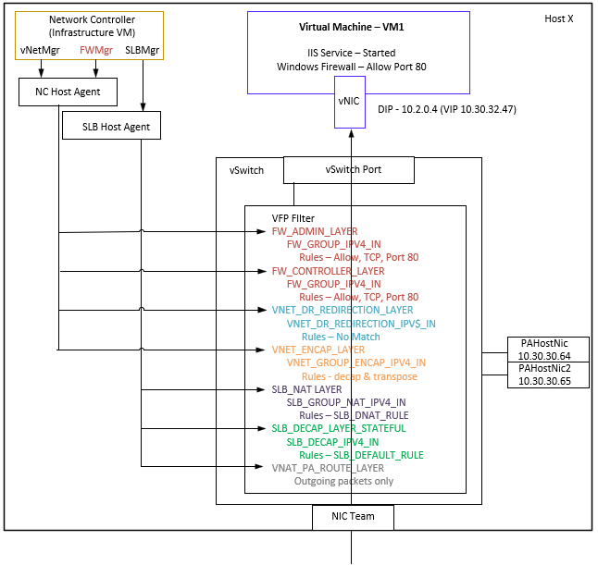
Virtual filtering platform (VFP)
Comprised of layers, groups, and rules.
ACLs are configured in the FW_Admin_Layer and FW_Control_Layer.
Groups for [IPv4 | IPv6] and [In | Out] will be associated with each layer.
Each of these groups will be configured with the rules.
Rules are applied in the virtual switch port of the appropriate VM network adapters.
Packets going in or out of the network adapter will be assessed against the rules and allowed or denied as appropriate.
Notes:
Within VFP, there are two unique layers related to the firewall policies.
We have what is called the Admin Layer which is associated to NSG policy applied to the network interface directly.
We also have a Controller Layer, which is associated to the NSG policy applied to the subnet.

Slide 18
Lab
Examine Firewall Manager Service.
Examine NCHostAgent.

Slide 19
Knowledge check
Which protocol is used to push goal state from the firewall service to the NCHostAgent?
Which two layers within VFP are associated to NSGs?
Notes:
See answers at end of the deck.

Slide 20
Describe Network Security Groups

Slide 21
Network Security Groups
NSGs are used to manage how the Datacenter Firewall operates.
Represented within NC NB API as /networking/<apiVersion>/accessControlLists/{resourceID}.
You can use NSGs to filter network traffic between resources.
NSGs contains security rules that allow or deny inbound/outbound traffic.
Each rule allows configuration of source, destination, port, and protocol (5-tuple).
NSGs can be applied against a network interface, virtual network subnet, logical network subnets, or security tags.
NSGs can be associated to multiple resources.

Slide 22
How NSGs are applied
When creating an NSG, nothing happens initially.
When you deploy a NIC and associate it to an NSG, the SDN FW will know there should be policy applied, however does not know where the NIC lives.
VM with a NIC attached has the port profile configured to 1 (VFP enabled) with instanceID of interface.
NCHostAgent will send notification to NIC.
SDNFW service will receive a notification and will push the goal state via OVSDB to the MS_Firewall database.

Slide 23
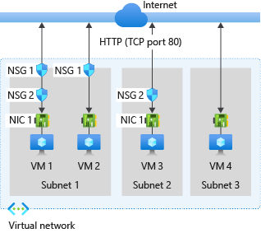
Inbound traffic
NSGs attached to subnet are evaluated first.
NSGs attached to network interface are then evaluated if allowed by subnet.
If no NSGs are present, all traffic is allowed.
Notes:
For inbound traffic, Azure processes the rules in a network security group associated to a subnet first, if there's one, and then the rules in a network security group associated to the network interface, if there's one. This includes intra-subnet traffic as well.
VM1: The security rules in NSG1 are processed, since it's associated to Subnet1 and VM1 is in Subnet1. Unless you've created a rule that allows port 80 inbound, the traffic is denied by the DenyAllInbound default security rule, and never evaluated by NSG2, since NSG2 is associated to the network interface. If NSG1 has a security rule that allows port 80, the traffic is then processed by NSG2. To allow port 80 to the virtual machine, both NSG1 and NSG2 must have a rule that allows port 80 from the internet.
VM2: The rules in NSG1 are processed because VM2 is also in Subnet1. Since VM2 doesn't have a network security group associated to its network interface, it receives all traffic allowed through NSG1 or is denied all traffic denied by NSG1. Traffic is either allowed or denied to all resources in the same subnet when a network security group is associated to a subnet.
VM3: Since there's no network security group associated to Subnet2, traffic is allowed into the subnet and processed by NSG2, because NSG2 is associated to the network interface attached to VM3.
VM4: Traffic is allowed to VM4, because a network security group isn't associated to Subnet3, or the network interface in the virtual machine. All network traffic is allowed through a subnet and network interface if they don't have a network security group associated to them.

Slide 24
Outbound traffic
NSGs applied to NIC are applied first.
NSGs attached to subnet are then evaluated if passes network interface NSG.
If no NSG is present, all traffic is allowed.
Notes:
For outbound traffic, Azure processes the rules in a network security group associated to a network interface first, if there's one, and then the rules in a network security group associated to the subnet, if there's one. This includes intra-subnet traffic as well.
VM1: The security rules in NSG2 are processed. Unless you create a security rule that denies port 80 outbound to the internet, the traffic is allowed by the AllowInternetOutbound default security rule in both NSG1 and NSG2. If NSG2 has a security rule that denies port 80, the traffic is denied, and never evaluated by NSG1. To deny port 80 from the virtual machine, either, or both of the network security groups must have a rule that denies port 80 to the internet.
VM2: All traffic is sent through the network interface to the subnet, since the network interface attached to VM2 doesn't have a network security group associated to it. The rules in NSG1 are processed.
VM3: If NSG2 has a security rule that denies port 80, the traffic is denied. If not, the traffic is allowed by the AllowInternetOutbound default security rule in NSG2, since a network security group isn't associated to Subnet2.
VM4: All network traffic is allowed from VM4, because a network security group isn't associated to the network interface attached to the virtual machine, or to Subnet3.

Slide 25
Intra-subnet traffic
NSGs can have direct impact on traffic within a subnet and across subnets.
By default, VMs within same subnet and within same virtual network can communicate with each other.
Flow logging can be used to confirm if traffic is allowed or denied, and which rules are applied.
Notes:
It's important to note that security rules in an NSG associated to a subnet can affect connectivity between VMs within it. By default, virtual machines in the same subnet can communicate based on a default NSG rule allowing intra-subnet traffic. If a rule is added to *NSG1 that denies all inbound and outbound traffic, VM1 and VM2 will no longer be able to communicate with each other.
You can easily view the aggregate rules applied to a network interface by viewing the rules for a network interface. You can also use the flow logging capability in within NC to determine whether communication is allowed to or from a network interface. IP flow verify tells you whether a communication is allowed or denied, and which network security rule allows or denies the traffic.

Slide 26
ACL resources
Resource | Description
aclRules | Indicates the rules in an access control list. See section 3.1.5.1.2 for full details on this element.
inboundDefaultAction | Indicates the default action for inbound rules. Valid values are Permit or Deny. The default value is Permit.
ipConfigurations | Indicates references to IP addresses of networkInterfaces resources this ACL is associated with.
outboundDefaultAction | Indicates the default action for outbound rules. Valid values are Permit or Deny. The default value is Permit.
subnets | Indicates an array of references to subnets resources this ACL is associated with.

Slide 27
Lab
Create NSG for a subnet.
Create NSG for NIC.
View ACLs (NSGs) within a network controller.
View Dataplane configuration.
Capture packet traces for firewall troubleshooting.

Slide 28
Knowledge check
Which resources can an NSG be associated with?
If an empty NSG is applied to a resource, what is the default action applied?
Notes:
See answers at end of the deck.

Slide 29
Understand security tags

Slide 30
Security tags
Security tags allow you to create NSGs and apply them to elements.
You no longer need to track network segments and know which subnet allows what access.
You can create simplified tags based on purpose and apply to a VM.
Referred to as ‘Service tags’ within Azure and Azure Stack.
Notes:
Security Tags
In Azure Stack HCI, version 21H2, you could create network security groups to configure access policies based on network constructs (network prefixes/subnets). So, if you want to prevent your Web Server VMs from communicating with your database VMs, you must identify corresponding network subnets and create policy to deny communication between those subnets.
With the network security tags feature, you no longer need to track the network segments where your applications are hosted. Using the same Web Server and database VMs example above, you can tag corresponding VMs with "Web" and "Database" network security tags. You can then create a network security group rule to prevent "Web" network security tag from communicating with "Database" network security tag.

Slide 31
Security tag resources
Resource | Description
type | A string that can be used to filter security tags after listing all security tags.
accessControlList | A reference to an accessControlLists resource (section 3.1.5.1) that defines the ACL rules to be applied to each NIC associated with this security tag.
networkInterfaces | An array of references to networkInterfaces resources (section 3.1.5.11) that this security tag is associated with.
aclRulesAsSource | An array of references to aclRules resources (section 3.1.5.1.2) that include this security tag in its SourceSecurityTags field.
aclRulesAsDestination | An array of references to aclRules resources that include this security tag in its DestinationSecurityTags field.

Slide 32
Lab
There’s no lab for the Security tags topic.

Slide 33
Knowledge check
What is a security tag?
Notes:
See answers at end of the deck.

Slide 34
Understand trace logging

Slide 35
Trace logging
As Firewall Service is part of the Network Controller, refer to M1_Network_Controller module regarding trace logging.

Slide 36
Audit logging
New functionality introduced in Windows Server 2019 allows audit logging to be enabled for NSGs.
These logs are consistent with Azure Network Watcher Flow Logs.
Once enabled, new files will start being logged on each host.
Logs are flushed from memory into the log file every hour.
Log file contains a sequence of flow events in JSON format.
Logging only happens for NSGs that have logging set to enabled.
Audit Logging can be configured by NC cmdlets directly or by leveraging WAC.

Slide 37
Lab
Enable flow audit logging.

Slide 38
Knowledge check
How often are audit events generated?
Notes:
See answers at end of the deck.

Slide 39
Resources
Network security group - how it works | Microsoft Learn
[MS-NCNBI]: accessControlLists | Microsoft Learn
[MS-NCNBI]: securityTags | Microsoft Learn
Overview of Datacenter Firewall in Azure Stack HCI and Windows Server - Azure Stack HCI | Microsoft Learn
Enable, assign default network access policies on Azure Stack HCI VMs - Azure Stack HCI | Microsoft Learn
Configure network security groups with tags in Windows Admin Center - Azure Stack HCI | Microsoft Learn
Configure network security groups with PowerShell - Azure Stack HCI | Microsoft Learn
Configure network security groups with Windows Admin Center - Azure Stack HCI | Microsoft Learn
What is Datacenter Firewall?

Slide 40
Knowledge check answers
Learning objective | Questions | Answers
1. Firewall overview | 1. How are firewall policies enforced? | Firewall policies are bound to the network and are applied within the virtual port of the virtual switch.
2. Firewall architecture | Which protocol is used to push goal state from Firewall Service to NCHostAgent? Which two layers within VFP are associated to NSGs? | OVSDB. Controller and Admin.
3. Network Security Groups | Which resources can an NSG be associated with? If an empty NSG is applied to a resource, what is the default action applied? | NSG can be associated with a network interface, a virtual network subnet, a logical network subnet, or a security tag. Deny.
4. Security tags | 1. What is a security tag? | A security tag enables you to create a NSG rule based on service or resource, rather than on a network boundary.
5. Tracing | 1. How often are Audit events generated? | Log files are generated for audit event every hour per host.

Slide 41
Summary
In this module, you learned about:
Firewall overview.
Firewall architecture.
Network Security Groups.
Security tags.
Tracing.

